Slide 1


Slide 2
The World State: A Perfect Society
Brave New World is set in the future of our own world, in the year 2450 A.D. The planet is united politically as the “World State.”
The World Controllers’ priority is their citizens’ happiness, no one in the World State has the opportunity to learn through suffering, or to experience solitude or loneliness. Art and religion don’t exist in the World State.

Slide 3
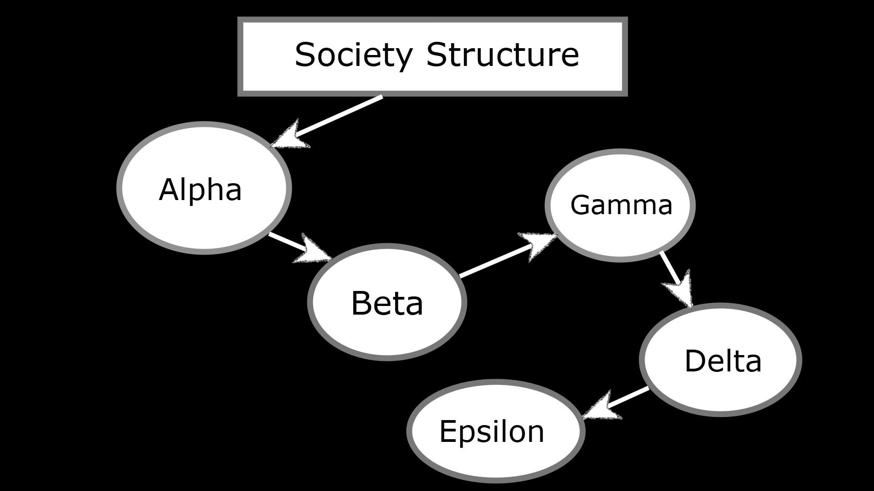
Structure of Society
Society is structured around a rigid caste system with five social classes:
Alphas, Betas, Gammas, Deltas, and Epsilons.
Each assigned specific roles and conditioned from birth.

Slide 4
The 5 castes in Brave New World
Alpha:
The highest caste, comprising intellectuals, scientists, and leaders, are conditioned to perform complex tasks and wear gray.
Beta:
Skilled workers who support the Alphas, requiring intelligence but perhaps not critical thought, and wear mulberry.
Gamma:
Semi-skilled workers, wearing green, who perform more physical and menial labor than the upper castes.
Delta:
Low-skill workers, such as packaging employees and machinists, wearing khaki, and have limited mental capacity.
Epsilon:
The lowest caste, performing menial labor like carrying and sewage work, and wear black.

Slide 5
Bernard Marx

Slide 6
Lenina Crowne

Slide 7
The Tragic Hero : John “The Savage”
(john’s fate) -> 2nd last person says

Slide 8
Role of Soma in Society
(soma as opium of the masses)

Slide 9
Conflict and Resolution

Slide 10
Observation of the Future
(Huxley’s vision of future)

Slide 11
Concept of Freedom and Control

Slide 12
Role of Happiness in Novel
(happiness derived from materialism vs happiness derived from personal growth)

Slide 13
Brave New World v/s Our World
(compare our world with novel’s world)

Slide 14
Legacy of Brave New World

Slide 15
Team members:
Ankit Kumar
Rishav Goswami
Vansh
Rahul
Yash
Subhasis

Slide 16
Thank You

